Slide 1
UNIT II

Slide 2
PHP Introduction
PHP is a recursive acronym for “PHP: Hypertext Preprocessor” -- It is a widely-used open source general-purpose scripting language that is especially suited for web development and can be embedded into HTML.

Slide 3
PHP Introduction
> PHP is a server-side scripting language
> PHP scripts are executed on the server
> PHP supports many databases (MySQL, Oracle, Sybase, Generic ODBC, etc.)‏
> PHP is open source software
> PHP is free to download and use

Slide 4
PHP Introduction
> PHP runs on different platforms (Windows, Linux, Unix, etc.)‏
> PHP is compatible with almost all servers used today (Apache, IIS, etc.)‏
> PHP is FREE to download from the official PHP resource: www.php.net
> PHP is easy to learn and runs efficiently on the server side

Slide 5
Instead of lots of commands to output HTML (as seen in C or Perl), PHP pages contain HTML with embedded code that does "something" (like in the next slide, it outputs "Hi, I'm a PHP script!").
The PHP code is enclosed in special start and end processing instructions <?php and ?> that allow you to jump into and out of "PHP mode."

Slide 6
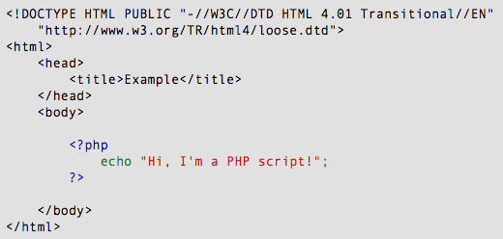
PHP Introduction

Slide 7
PHP Introduction
PHP code is executed on the server, generating HTML which is then sent to the client. The client would receive the results of running that script, but would not know what the underlying code was.
A visual, if you please...

Slide 8
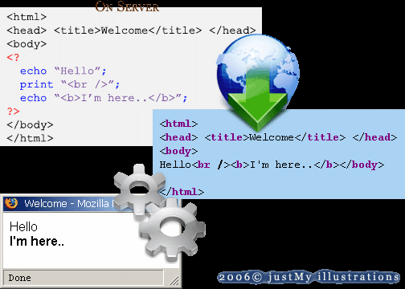
PHP Introduction

Slide 9
PHP Getting Started
On windows, you can download and install WAMP. With one installation and you get an Apache webserver, database server and php.
http://www.wampserver.com
On mac, you can download and install MAMP.
http://www.mamp.info/en/index.html

Slide 10
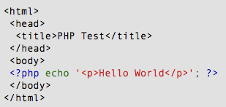
PHP Hello World
Above is the PHP source code.

Slide 11
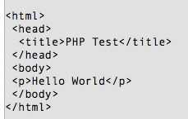
PHP Hello World
It renders as HTML that looks like this:

Slide 12
PHP Hello World
This program is extremely simple and you really did not need to use PHP to create a page like this. All it does is display: Hello World using the PHP echo() statement.
Think of this as a normal HTML file which happens to have a set of special tags available to you that do a lot of interesting things.

Slide 13
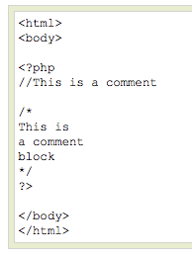
PHP Comments
In PHP, we use // to make a single-line comment or /* and */ to make a large comment block.

Slide 14
DATA TYPES IN PHP

Slide 15
Data Types (1)
PHP has eight different data types – 5 basic and 2 composite types and 1 resource type
The 5 basic data types are:
integers : whole numbers in the range -2,147,483,648 to +2,147,483,647 on 32-bit architecture. Can be octal (prefixed by 0), decimal and hexadecimal (prefixed by 0x)
floating-point : real or doubles (decimal), can be written using base 10 notation (e.g. 3900 == 3.9e3)
strings : sequence of characters contained by single (‘..’) or double (“..”) quotes. Within double quotes variables are replaced by their values (interpolated). Escape sequences are used to include special characters within double quoted strings (e.g. \” to include a double quote and \\ to include a backslash)
booleans : the boolean data type evaluates to either true or false (e.g. $a == $b will evaluate to true if both variables contain the same value, false otherwise
null : a special data type that stands for a lack of value. Often used to initialize or reset variables.

Slide 16
Data Types (2)
arrays : are a composite data type that collect values into a list. The values of the array elements can be text, a number or even another array. Arrays can be from 1 to any number of dimensions.
- arrays are referenced using square [ .. ] brackets.
<?php
$cities[0] = “London”;
$cities[1] = “Bath”;
$cities[2] = “Bristol”;
print (“I live in $cities[2].<br/>\n”);
?>
- an array can be indexed using a string value for the index (called associative array or hash) and are useful in situations where there is a need to collect different types of data into one array. (e.g. $userInfo [“name”] = “Kevin”; )
- array elements containing other arrays are used to build multi-dimensional arrays.
<?php
$modules = array(
“ISD”=>array(
“Joe”,
“Tim”,
“Mary”
)
“ISDP”=>array(
“Bob”,
“Tom”,
“Sue”
)
);
print ($modules[“ISD”][2]);
?>

Slide 17
Data Types (3)
objects : are another composite data type fully supported by php.
- php supports standard object-oriented (OO) methodologies and techniques such as
inheritance - the ability to derive new classes from existing ones and inherit or override their attributes and methods.
encapsulation - the ability to hide data from users of the class (the public, protected and private keywords.)
special methods - for instance, code that is automatically run when a object is created (constructor) or destroyed (destructor).
polymorphism – overloading a function so that a function call will behave differently when passed variables of different type.
- a good introducton to OO programming using php can be found at
resources : are a data type that hold handles to external resources such as open files or database connections.

Slide 18
Assign a string to variable $testString
Assign a double to variable $testDouble
Assign an integer to variable $testInteger
EXAMPLE OF ASSIGNING DATA TYPES IN PHP

Slide 19

PHP Variables
> Variables are used for storing values, like text strings, numbers or arrays.
> When a variable is declared, it can be used over and over again in your script.
> All variables in PHP start with a $ sign symbol.
> The correct way of declaring a variable in PHP:

Slide 20

PHP Variables
> In PHP, a variable does not need to be declared before adding a value to it.
> In the example above, you see that you do not have to tell PHP which data type the variable is.
> PHP automatically converts the variable to the correct data type, depending on its value.

Slide 21
PHP Variables
> A variable name must start with a letter or an underscore "_" -- not a number
> A variable name can only contain alpha-numeric characters, underscores (a-z, A-Z, 0-9, and _ )‏
> A variable name should not contain spaces. If a variable name is more than one word, it should be separated with an underscore ($my_string) or with capitalization ($myString)‏

Slide 22
Constants In Php

Slide 23
Sometimes, you don’t want a data item to be a variable. For example, the value of pi shouldn’t change.
The thing to do here is to create a constant, whose value can’t be modified.
You create a constant in PHP with the define function:

Slide 24
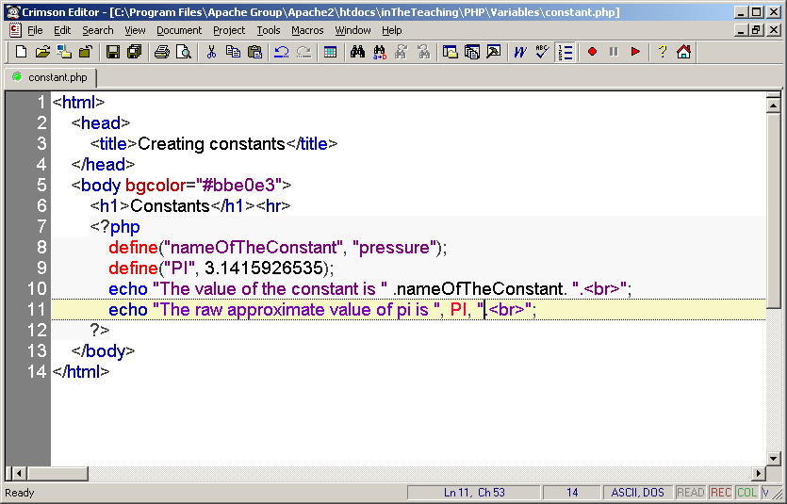

Slide 25
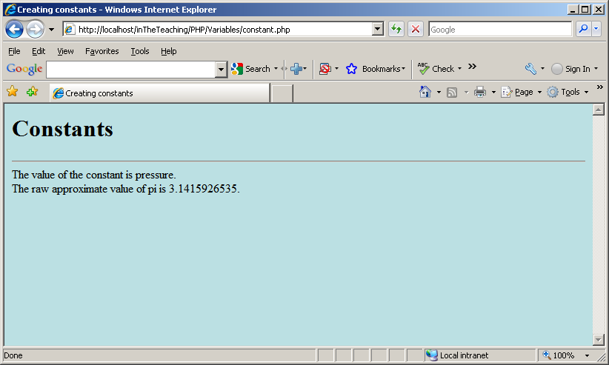

Slide 26
The define() function defines a constant.
Constants are much like variables, except for the following differences:
A constant's value cannot be changed after it is set
Constant names do not need a leading dollar sign ($)
Constants can be accessed regardless of scope
Constant values can only be strings and numbers
Syntax
define(name,value,case_insensitive)
Parameter Description
name Required. Specifies the name of the constant
value Required. Specifies the value of the constant
case_insensitive Optional. Specifies whether the
constant name should be case-insensitive. If set to TRUE,
the constant will be case-insensitive. Default is FALSE
(case-sensitive)

Slide 27
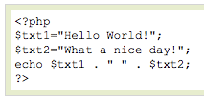
PHP Concatenation
> The concatenation operator (.) is used to put two string values together.
> To concatenate two string variables together, use the concatenation operator:

Slide 28

PHP Concatenation
The output of the code on the last slide will be:
If we look at the code you see that we used the concatenation operator two times. This is because we had to insert a third string (a space character), to separate the two strings.

Slide 29
PHP Operators
Operators are used to operate on values. There are four classifications of operators:
> Arithmetic
> Assignment
> Comparison
> Logical

Slide 30
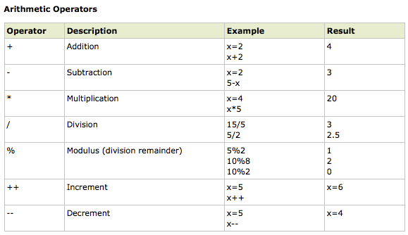
PHP Operators

Slide 31
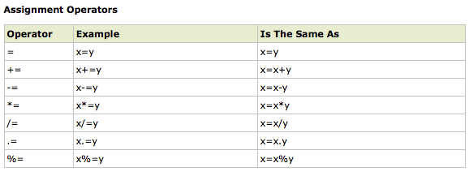
PHP Operators

Slide 32
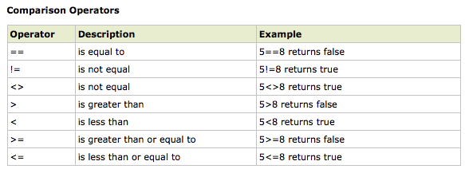
PHP Operators

Slide 33
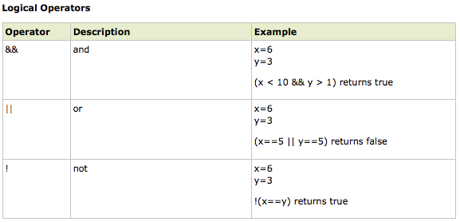
PHP Operators

Slide 34
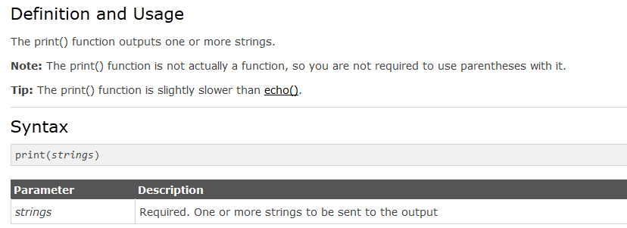
Printing Data
print() Function

Slide 35
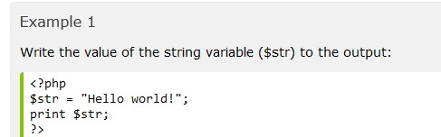


Slide 36
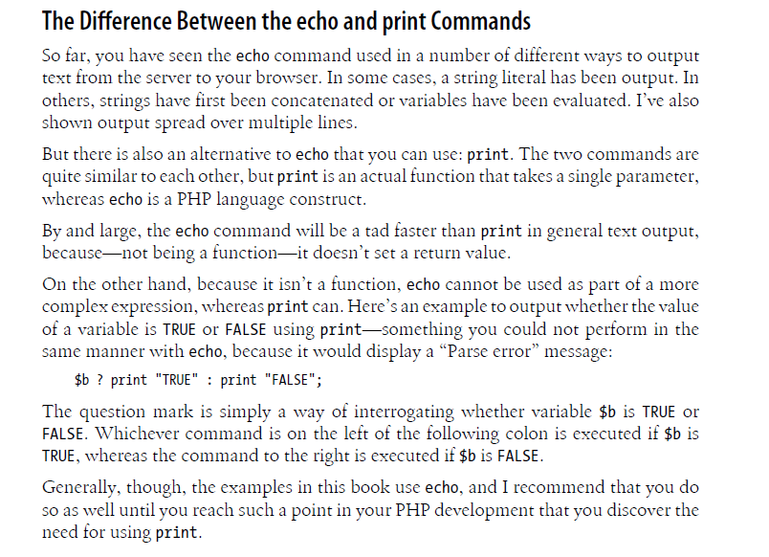

Slide 37
PHP Conditional Statements
> Very often when you write code, you want to perform different actions for different decisions.
> You can use conditional statements in your code to do this.
> In PHP we have the following conditional statements...

Slide 38
PHP Conditional Statements
> if statement - use this statement to execute some code only if a specified condition is true
> if...else statement - use this statement to execute some code if a condition is true and another code if the condition is false
> if...elseif....else statement - use this statement to select one of several blocks of code to be executed
> switch statement - use this statement to select one of many blocks of code to be executed

Slide 39
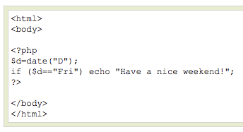
PHP Conditional Statements
The following example will output "Have a nice weekend!" if the current day is Friday:

Slide 40
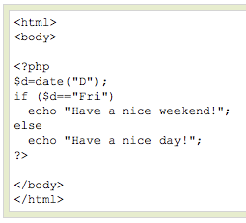
PHP Conditional Statements
Use the if....else statement to execute some code if a condition is true and another code if a condition is false.

Slide 41
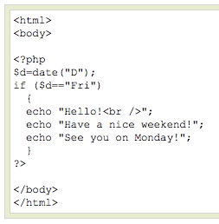
PHP Conditional Statements
If more than one line should be executed if a condition is true/false, the lines should be enclosed within curly braces { }

Slide 42
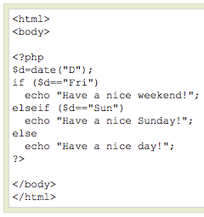
PHP Conditional Statements
The following example will output "Have a nice weekend!" if the current day is Friday, and "Have a nice Sunday!" if the current day is Sunday. Otherwise it will output "Have a nice day!":

Slide 43
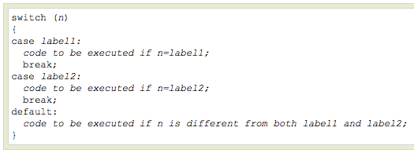
PHP Conditional Statements
Use the switch statement to select one of many blocks of code to be executed.

Slide 44
PHP Conditional Statements
For switches, first we have a single expression n (most often a variable), that is evaluated once.
The value of the expression is then compared with the values for each case in the structure. If there is a match, the block of code associated with that case is executed.
Use break to prevent the code from running into the next case automatically. The default statement is used if no match is found.

Slide 45
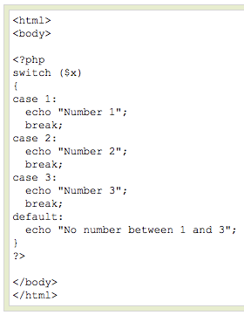
PHP Conditional Statements

Slide 46
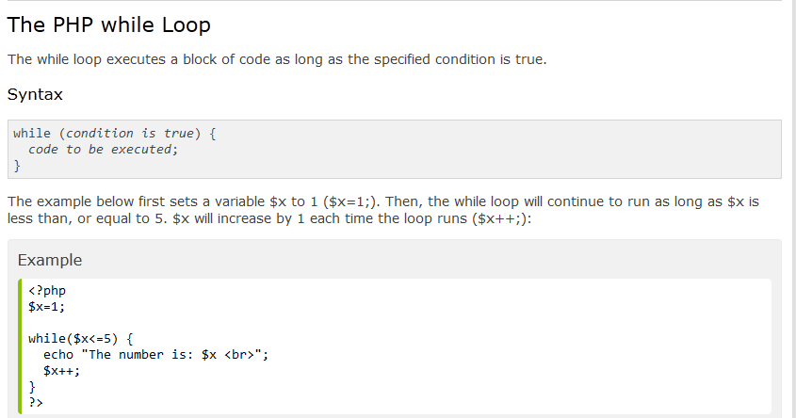
Loops in Php

Slide 47
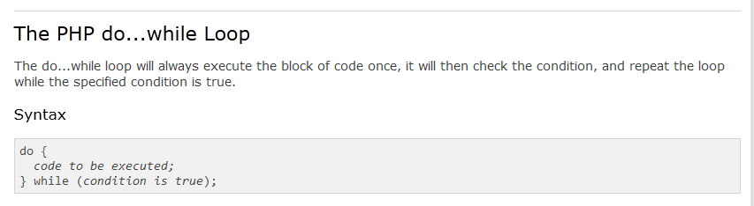

Slide 48
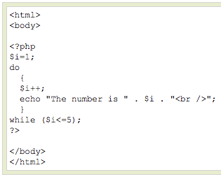
PHP Loops – Do ... While

Slide 49
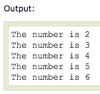
PHP Loops – Do ... While

Slide 50
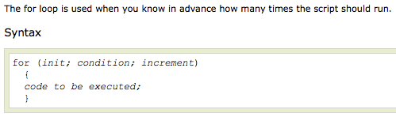
PHP Loops - For

Slide 51
PHP Loops - For
Parameters:
> init: Mostly used to set a counter (but can be any code to be executed once at the beginning of the loop)‏
> condition: Evaluated for each loop iteration. If it evaluates to TRUE, the loop continues. If it evaluates to FALSE, the loop ends.
> increment: Mostly used to increment a counter (but can be any code to be executed at the end of the loop)‏

Slide 52
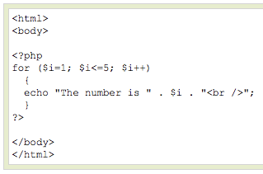
PHP Loops - For
The example below defines a loop that starts with i=1. The loop will continue to run as long as i is less than, or equal to 5. i will increase by 1 each time the loop runs:

Slide 53
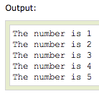
PHP Loops - For

